Slide 1

Performance Analysis
& Analysis driven budget allocation
Praveen Kumar Kanta
03/09/2026

Slide 2
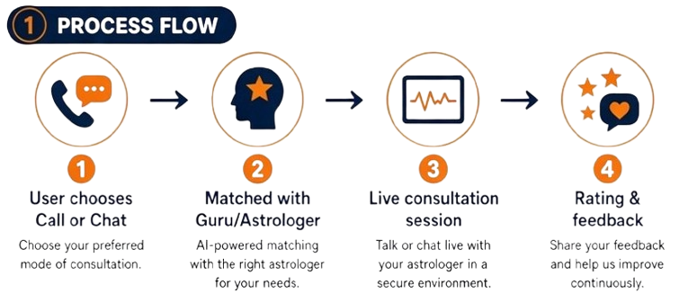
Introduction
Mobile Pioneer: Long before modern app stores existed, AstroSage launched "Mobile Kundli" in 2001 for Palm handheld devices, making it one of India's earliest consumer mobile applications.
Cloud Innovator: The platform introduced AstroSage Cloud in 2004, marking the country's first consumer cloud-based service for personal data and astrological charts.
Early AI Adoption: AstroSage launched Bhrigoo.ai in 2018, establishing one of the world's earliest AI-powered Vedic astrologers years before generative AI became a mainstream global trend.
Source: AstroSage Website

Slide 3
Problem Statement
Optimizing the Call Center operations for AstroSage:
  which has received a 1 Cr investment.
The goal is to determine how to allocate this investment to maximize:
  operational efficiency
  customer satisfaction
  profitability.
This project will involve analysing:
  historical call data
  performance metrics
  market trends
  to make informed decisions.

Slide 4

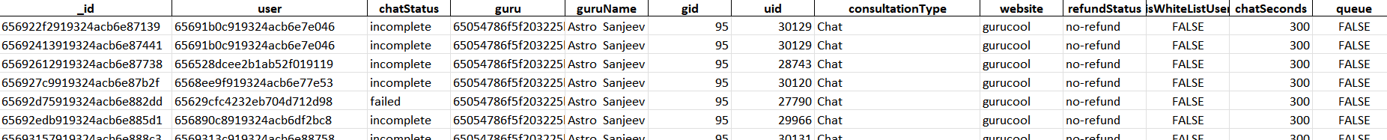
Data Summary
~ONE MONTH Data with:
  28027 records with 35 attributes
  Mainly From 2 channels: Call and Chat
  Stats from both user and agent end combined
  15+ categorical attributes, mostly around Call and Chat metrics and statuses.

Slide 5

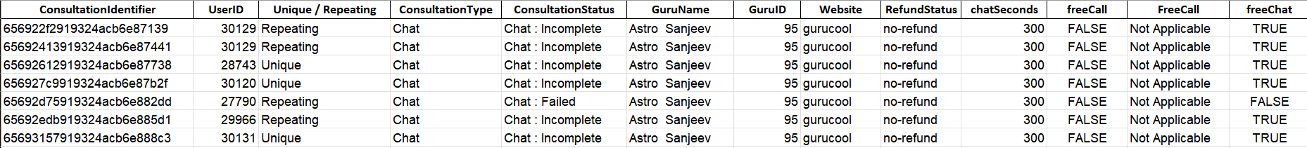
Cleaning Data
Action | Why? | How?
All Headers now have _, spaces stripped off and Uppercase first letter | Improves readability & Essential for Creating Pivot Charts | =PROPER(), =TRIM()
Unified /Standardized Status to show both Calls and Chats as same attribute | Overall performance measurement needs unified data, especially charts. | =CONCATENATE, &, Lookup functions
Reordered the Columns and created new columns | Understand what’s happening in short time | =IF() | =IF(IF(),) | String Ops | lookup functions
Separated Date from Time | Better readability | Text To Columns
Removed few Columns such as hash / identifiers | We have in master data anyway | Select | Delete

Slide 6
Daily Call Volume
The call volume shows an OVERALL DOWNTREND with a peak in Mid-December 2023 and slowly declined towards early January 2024
We have an average daily volume of ~250 records / day
Max recorded 430 on 10th Dec
Minimum on 3rd Jan with 107 records. (Only 3 days in Jan anyway)

Slide 7
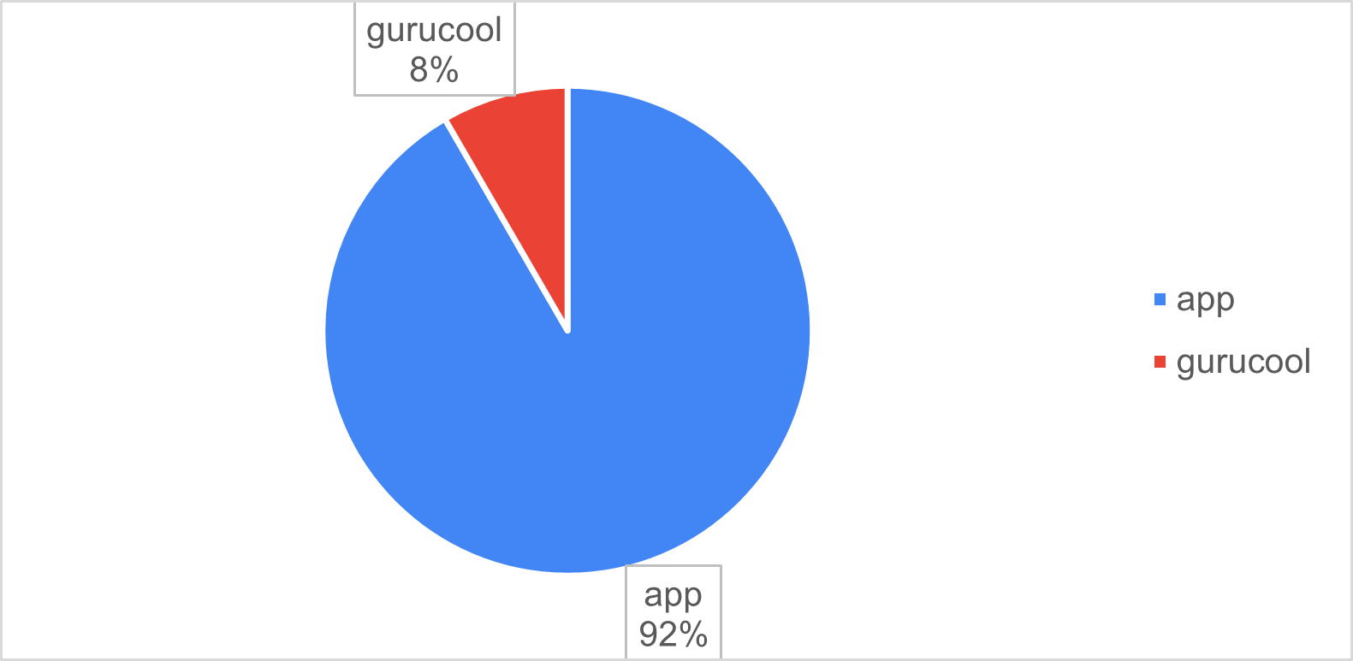
Call Volume Distribution
92% of the calls are through the App

Slide 8
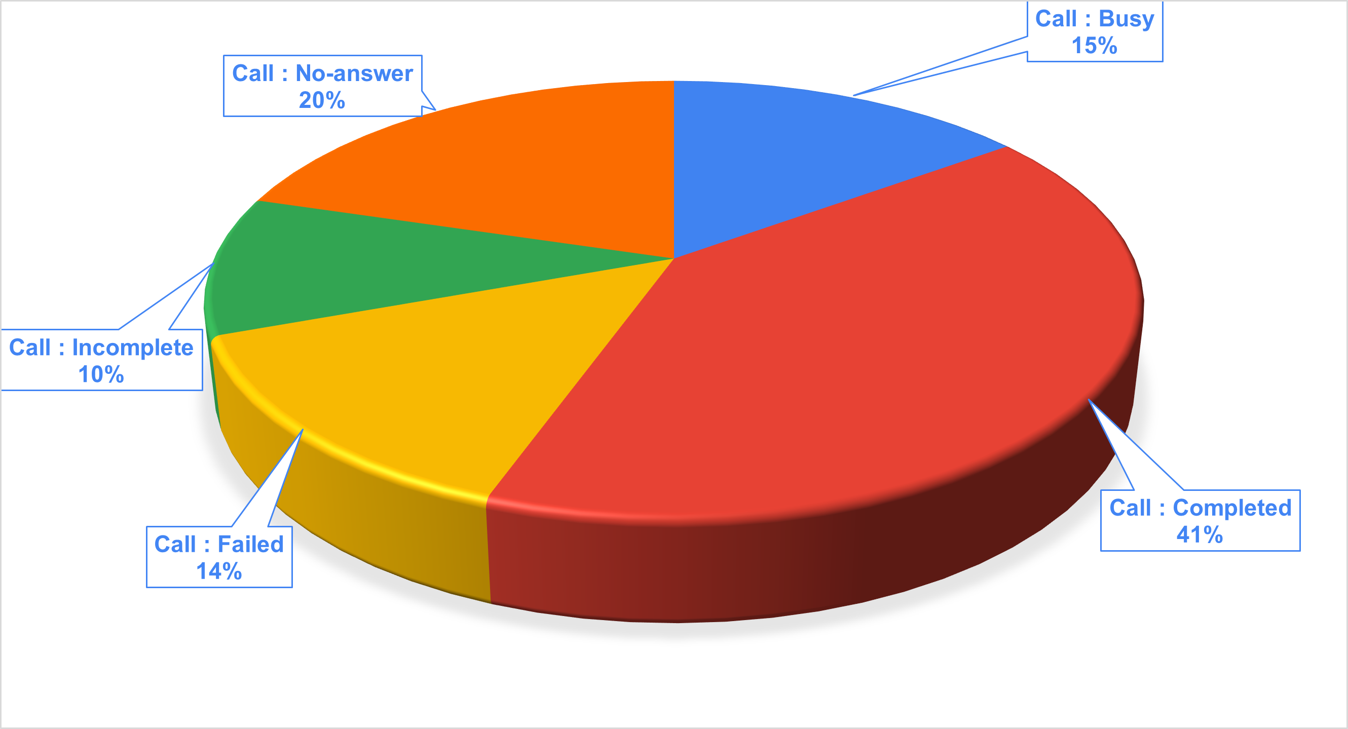
Call Status
Only 41% of the calls are complete.
35% is responsible to lack of Operators.
Busy
No-Answer
24% seems a Technology issue.
Incomplete
Failed

Slide 9
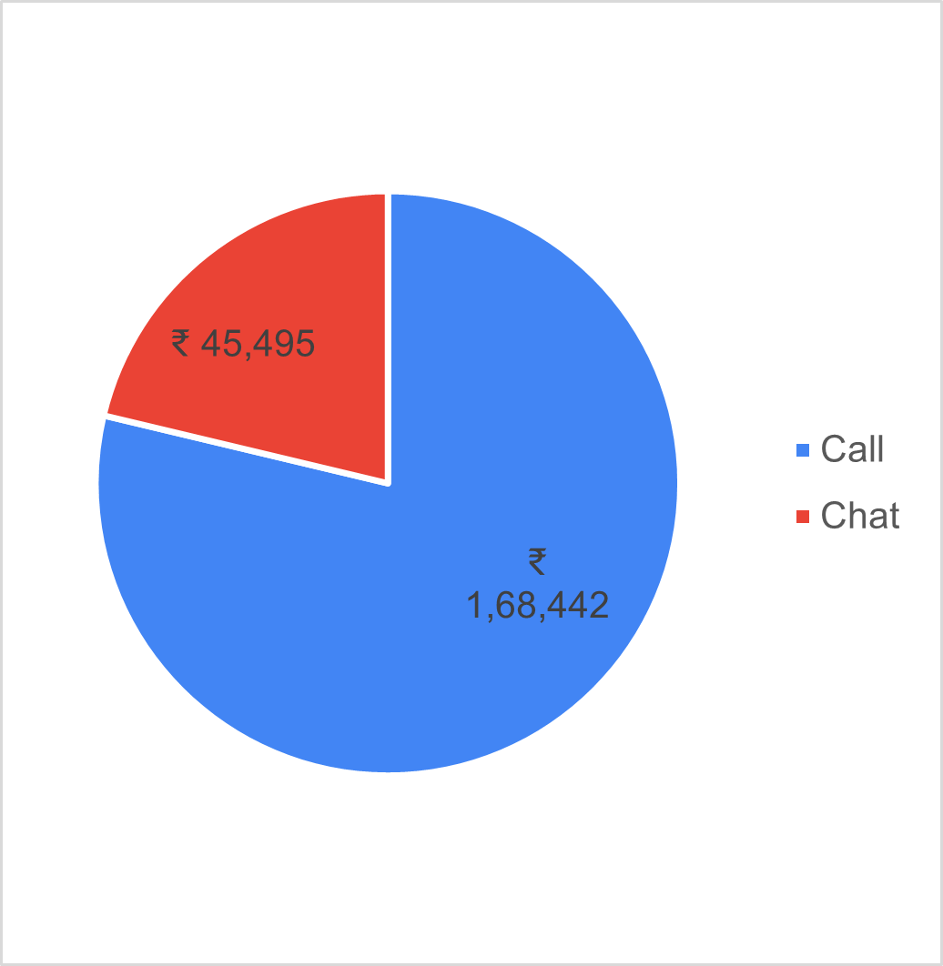
Revenue
Through | Revenue
Call | ₹ 1,68,442
Chat | ₹ 45,495
Total | ₹ 2,13,937
₹ 1,68,442 is from Call making it biggest source of revenue accounting to ~80% of the Revenue

Slide 10
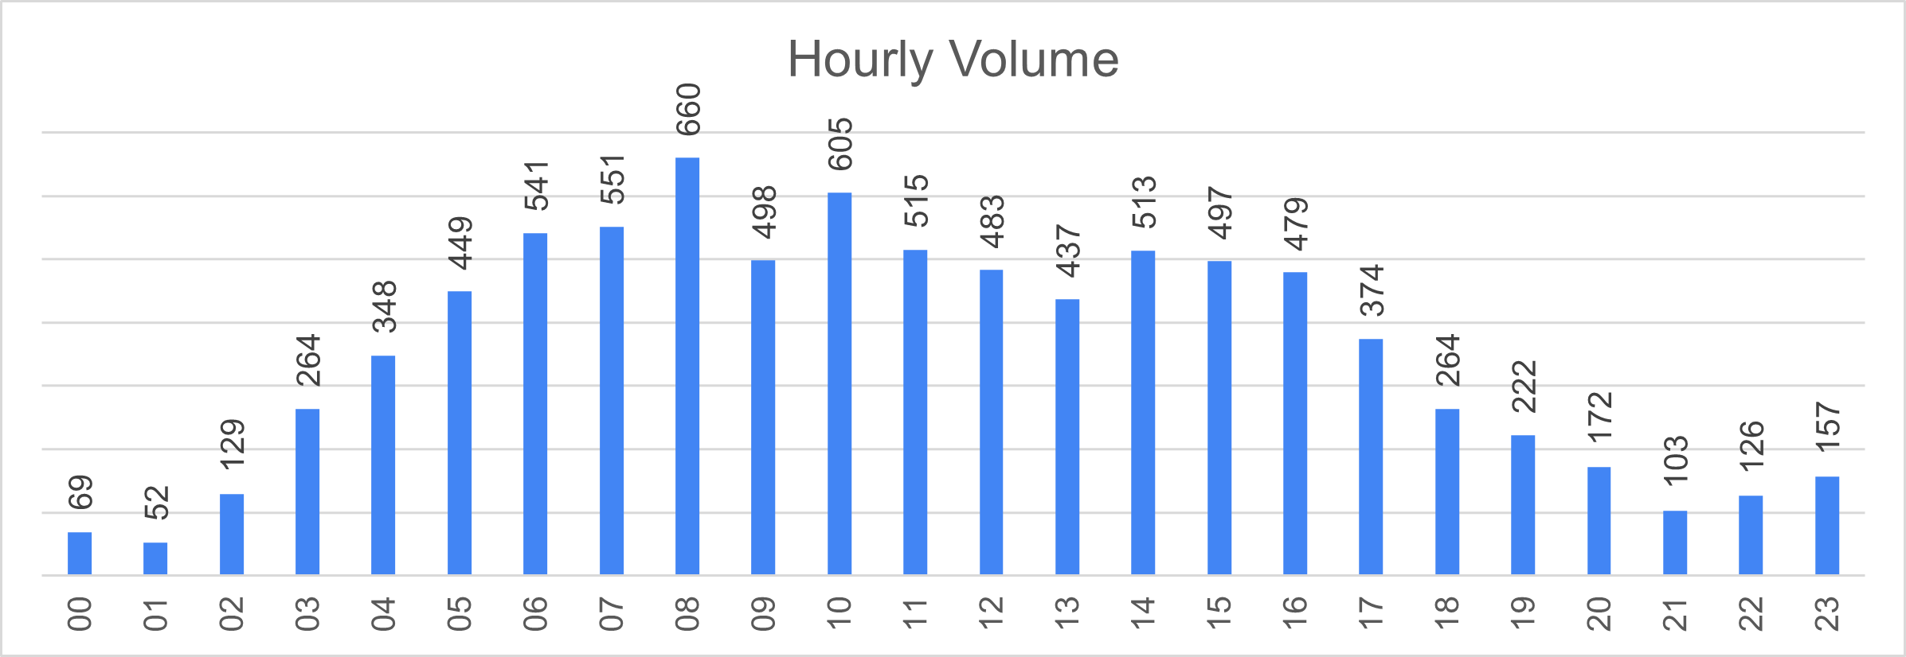
Peak Hours
06:00 – 10:00 are the Peak Hours
20:00 – 03:00 are the Silent Hours

Slide 11
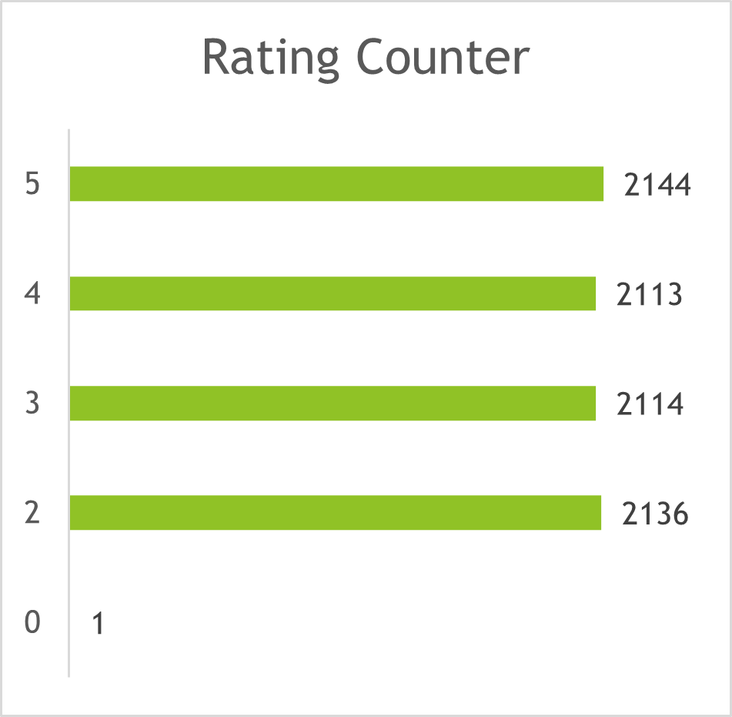
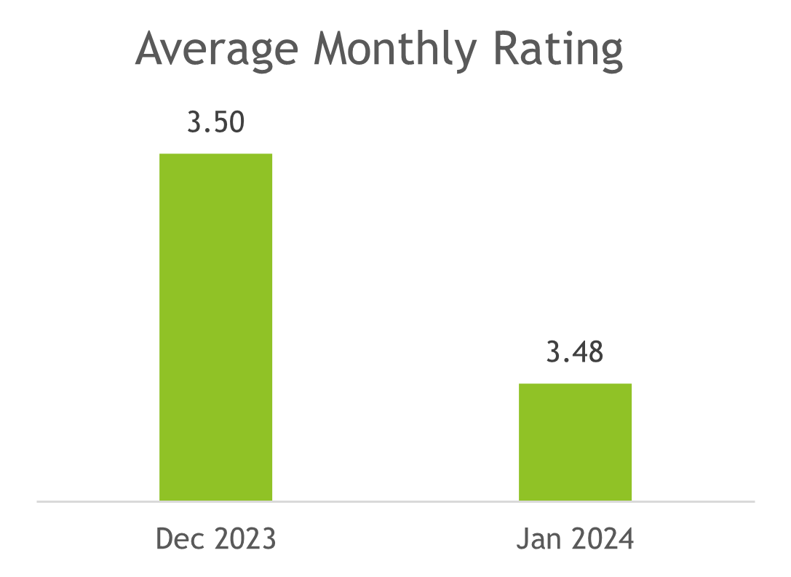
Call Rating
No call ever received 6 and above.
Training needed!
The Overall Rating remains < 4 for both months.

Slide 12
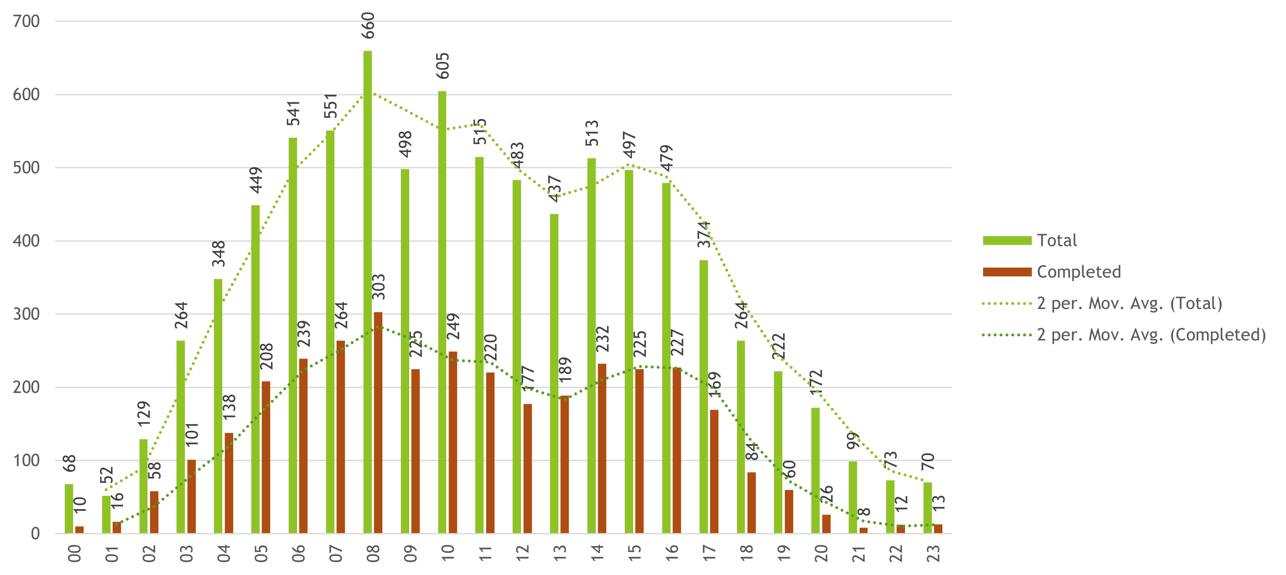
Hourly Volume vs Completed
At Peak Hours, the COMPLETION RATE is significantly LOW.

Slide 13
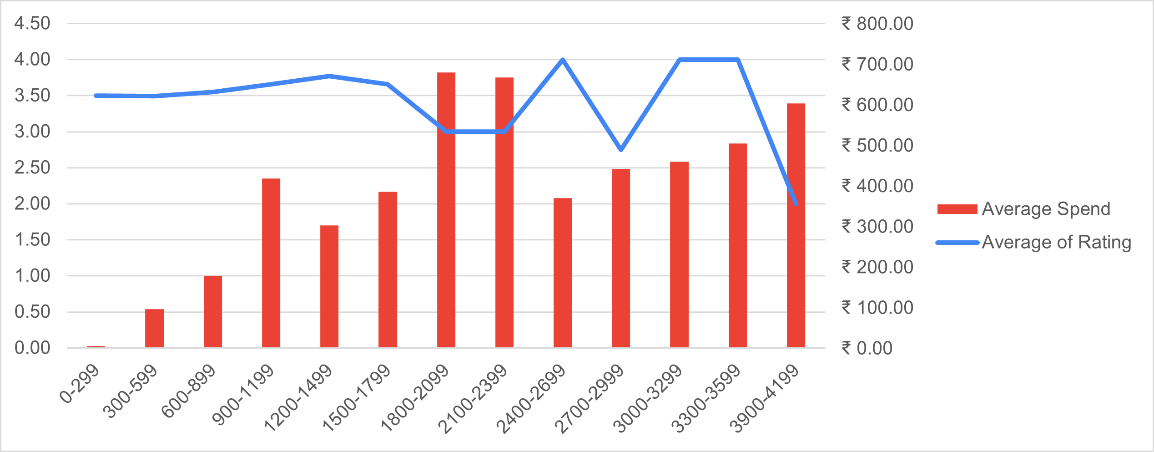
Duration vs SPEND vs RATING
30 MIN – 40 MIN Range is Abnormally Opposite.
SPEND is inversely proportional to SPEND
At Higher Durations, RATING collapse due to High Spend.

Slide 14
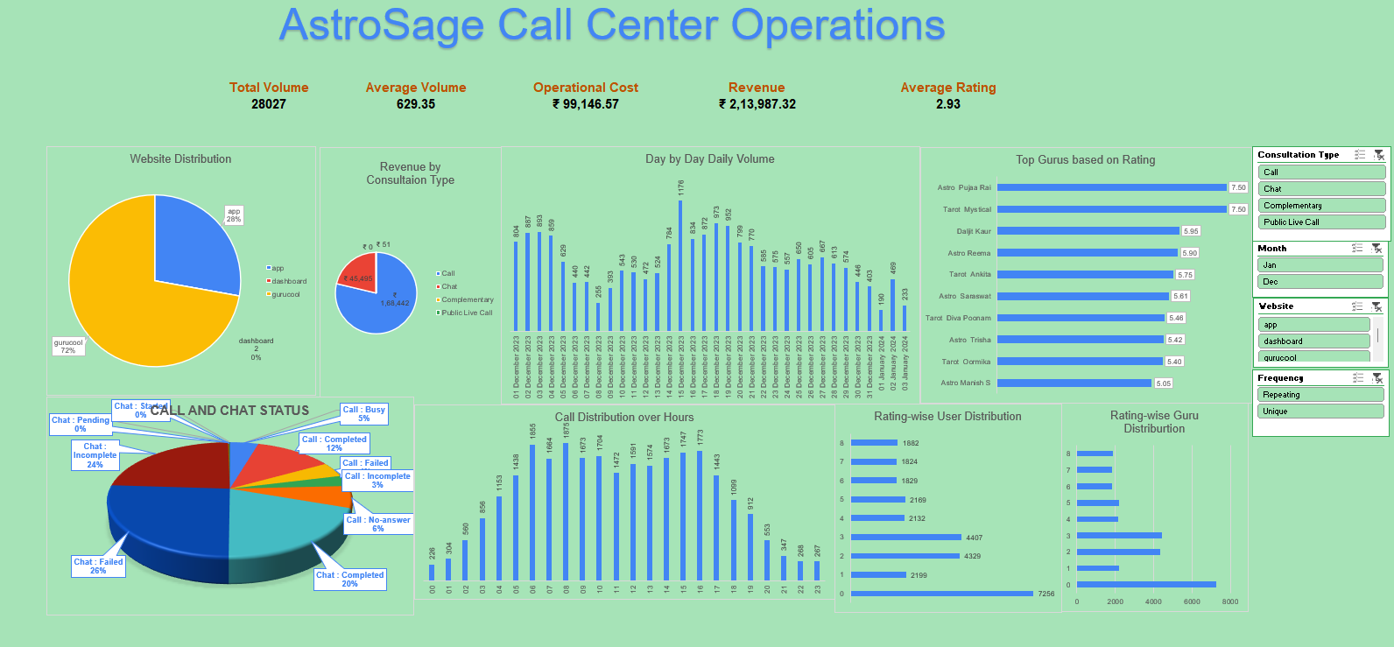

Slide 15
Recommendations
Platform Fix: Only ~40% Call Completion, Better Call Routing System is Needed.
Discounted Tariff for Long Callers.
Divide shifts into 4H slots, especially
06:00 – 10:00
10:00 – 14:00
14:00 – 18:00
Distribute Call volume among all Agents: Avoid Burnout.

Slide 16
Conclusions
The Call center performance of AstroSage data has been cleaned and thoroughly analysed.
Insights through various KPIs have been deduced and a real-time dashboard has been generated.
Improvement plans have been structured and recommended.

